Slide 1

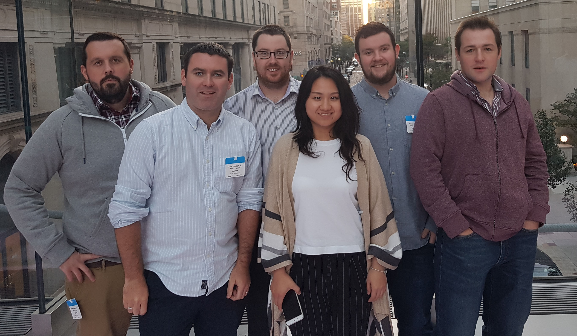
Activity Recognition in Realtime Video
Team: The Gang Does Ignite
Opportunity Area: Predictive Protection
Andy O’Sullivan, Yamin Xue, Robbie Byrne, Darragh Maloney, Daniel Boyle, Robbie Kavanagh

Slide 2
“More than one billion dollars
a week —
that’s what U.S. businesses lose to serious, non-fatal workplace injuries.”
- 2019 Liberty Mutual Workplace Safety Index

Slide 3
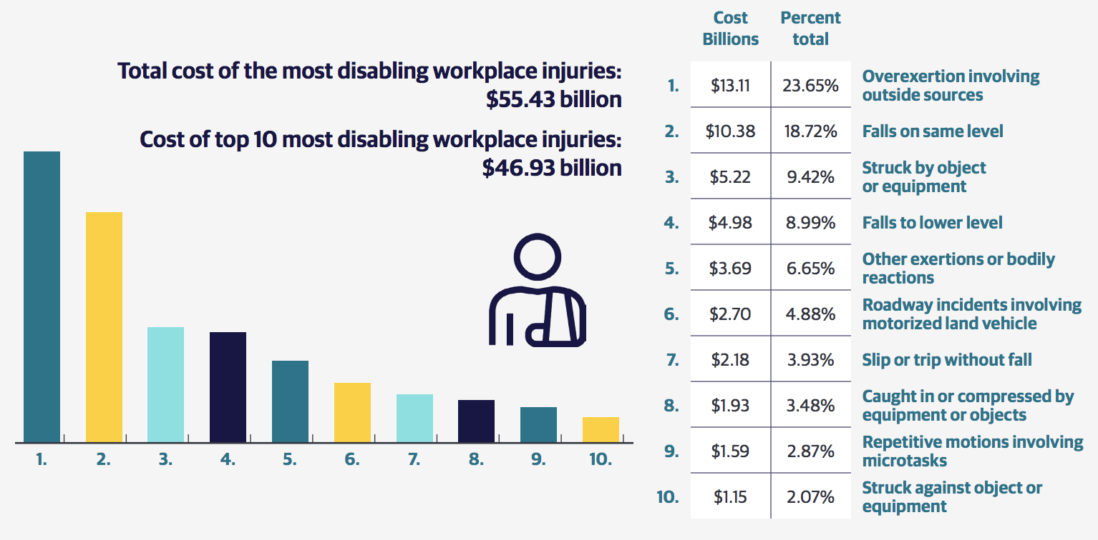

Slide 4


Machine Learning based Video Recognition, for our Customers to use in their workplaces.
Reduce Risk
Reduce Claims
Generate Revenue

Slide 5



High Level Solution
Live
Video Stream
Raise Alerts
Machine Learning
Models

Slide 6
Business Input
GRS National Insurance Risk Control Services
Expertise in workplace safety
Relationships with commercial customers
Discussing continuing project after Ignite
Wayne
Maynard
Nick
Shah

Slide 7
Customer Input
Met a LM customer with RCS: a large construction company (10,000+ staff) already looking for help in this area.
Real-world requirements and feedback.
Potential for collaboration to solve a real customer problem with cutting-edge technology.
“I’m glad to know Liberty
is researching this type of capability”

Slide 8



High-level Flow (as built at Ignite)
TensorFlow
PoseNet
Machine Learning
Dashboard
Custom
Algorithms
Live Video
AWS
SES
Mobile
Email alerts
AWS Kinesis
Video streaming
AWS
Rekognition

Slide 9
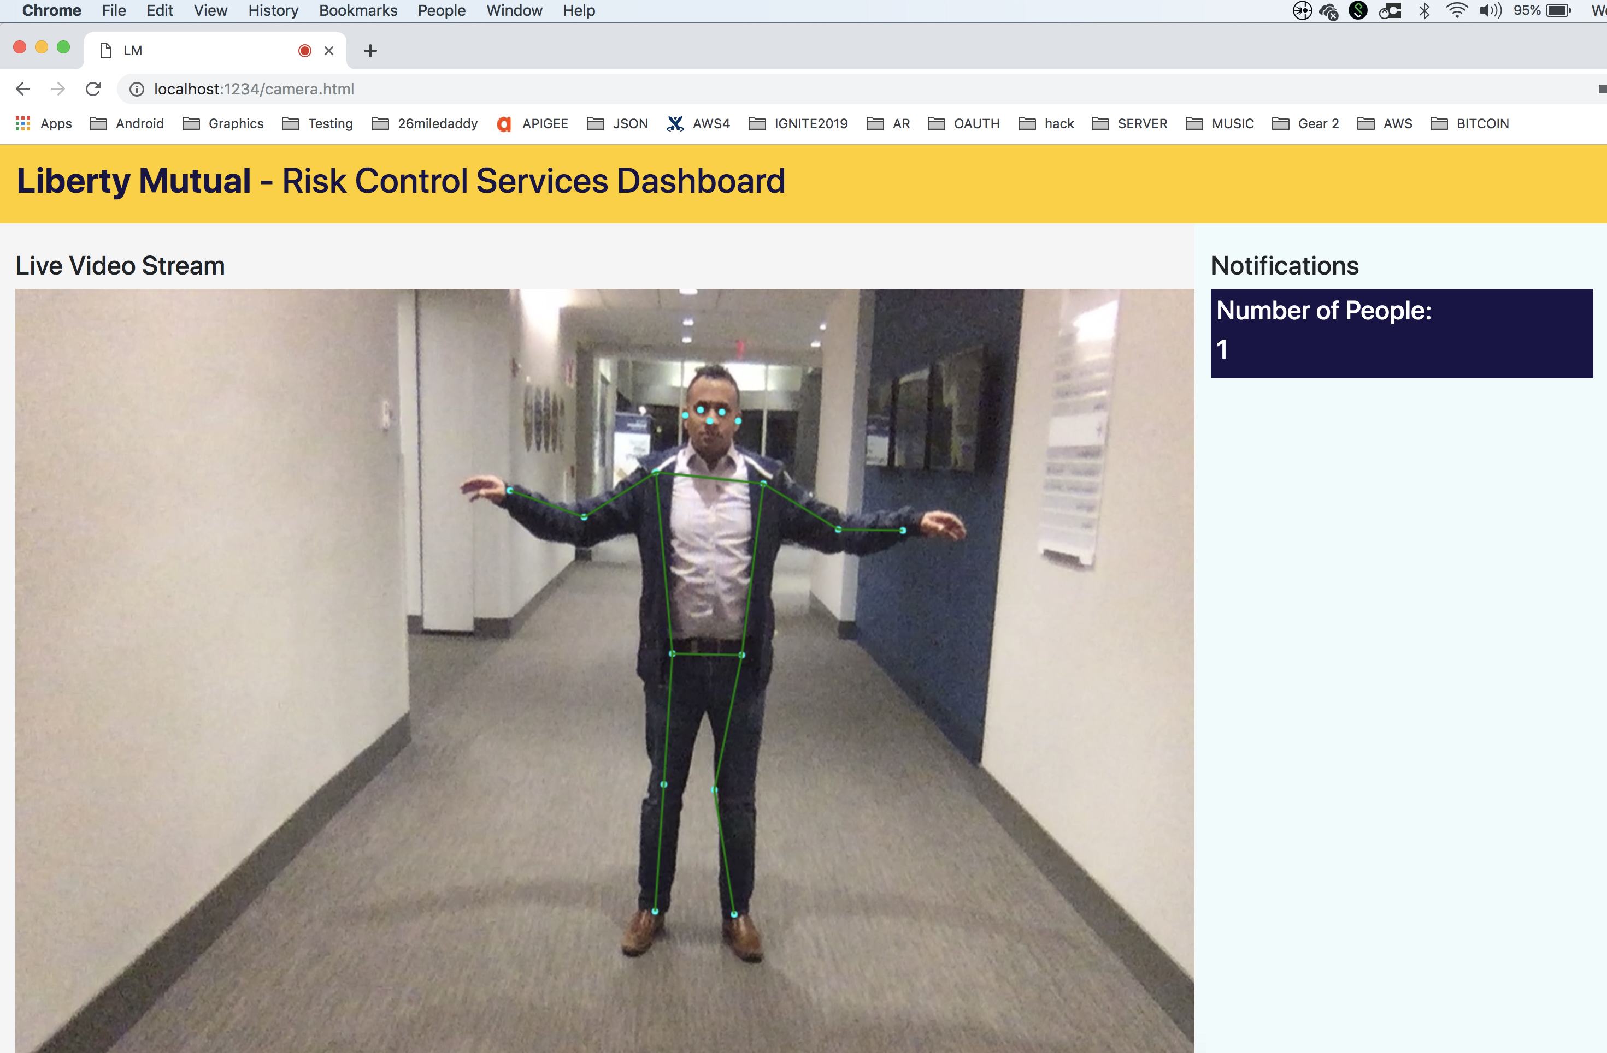
TensorFlow Posenet – Pose Estimation
(Nick)

Slide 10
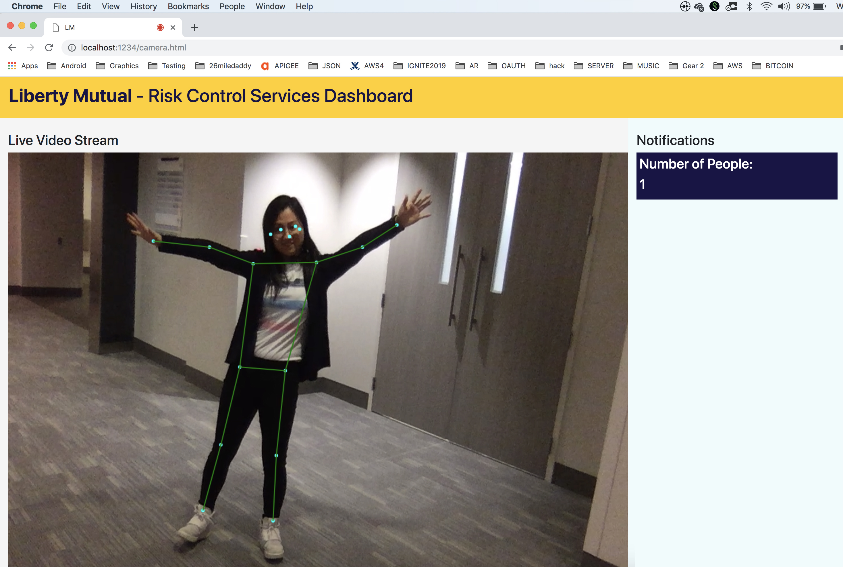
TensorFlow Posenet – Pose Estimation
(Yamin)

Slide 11
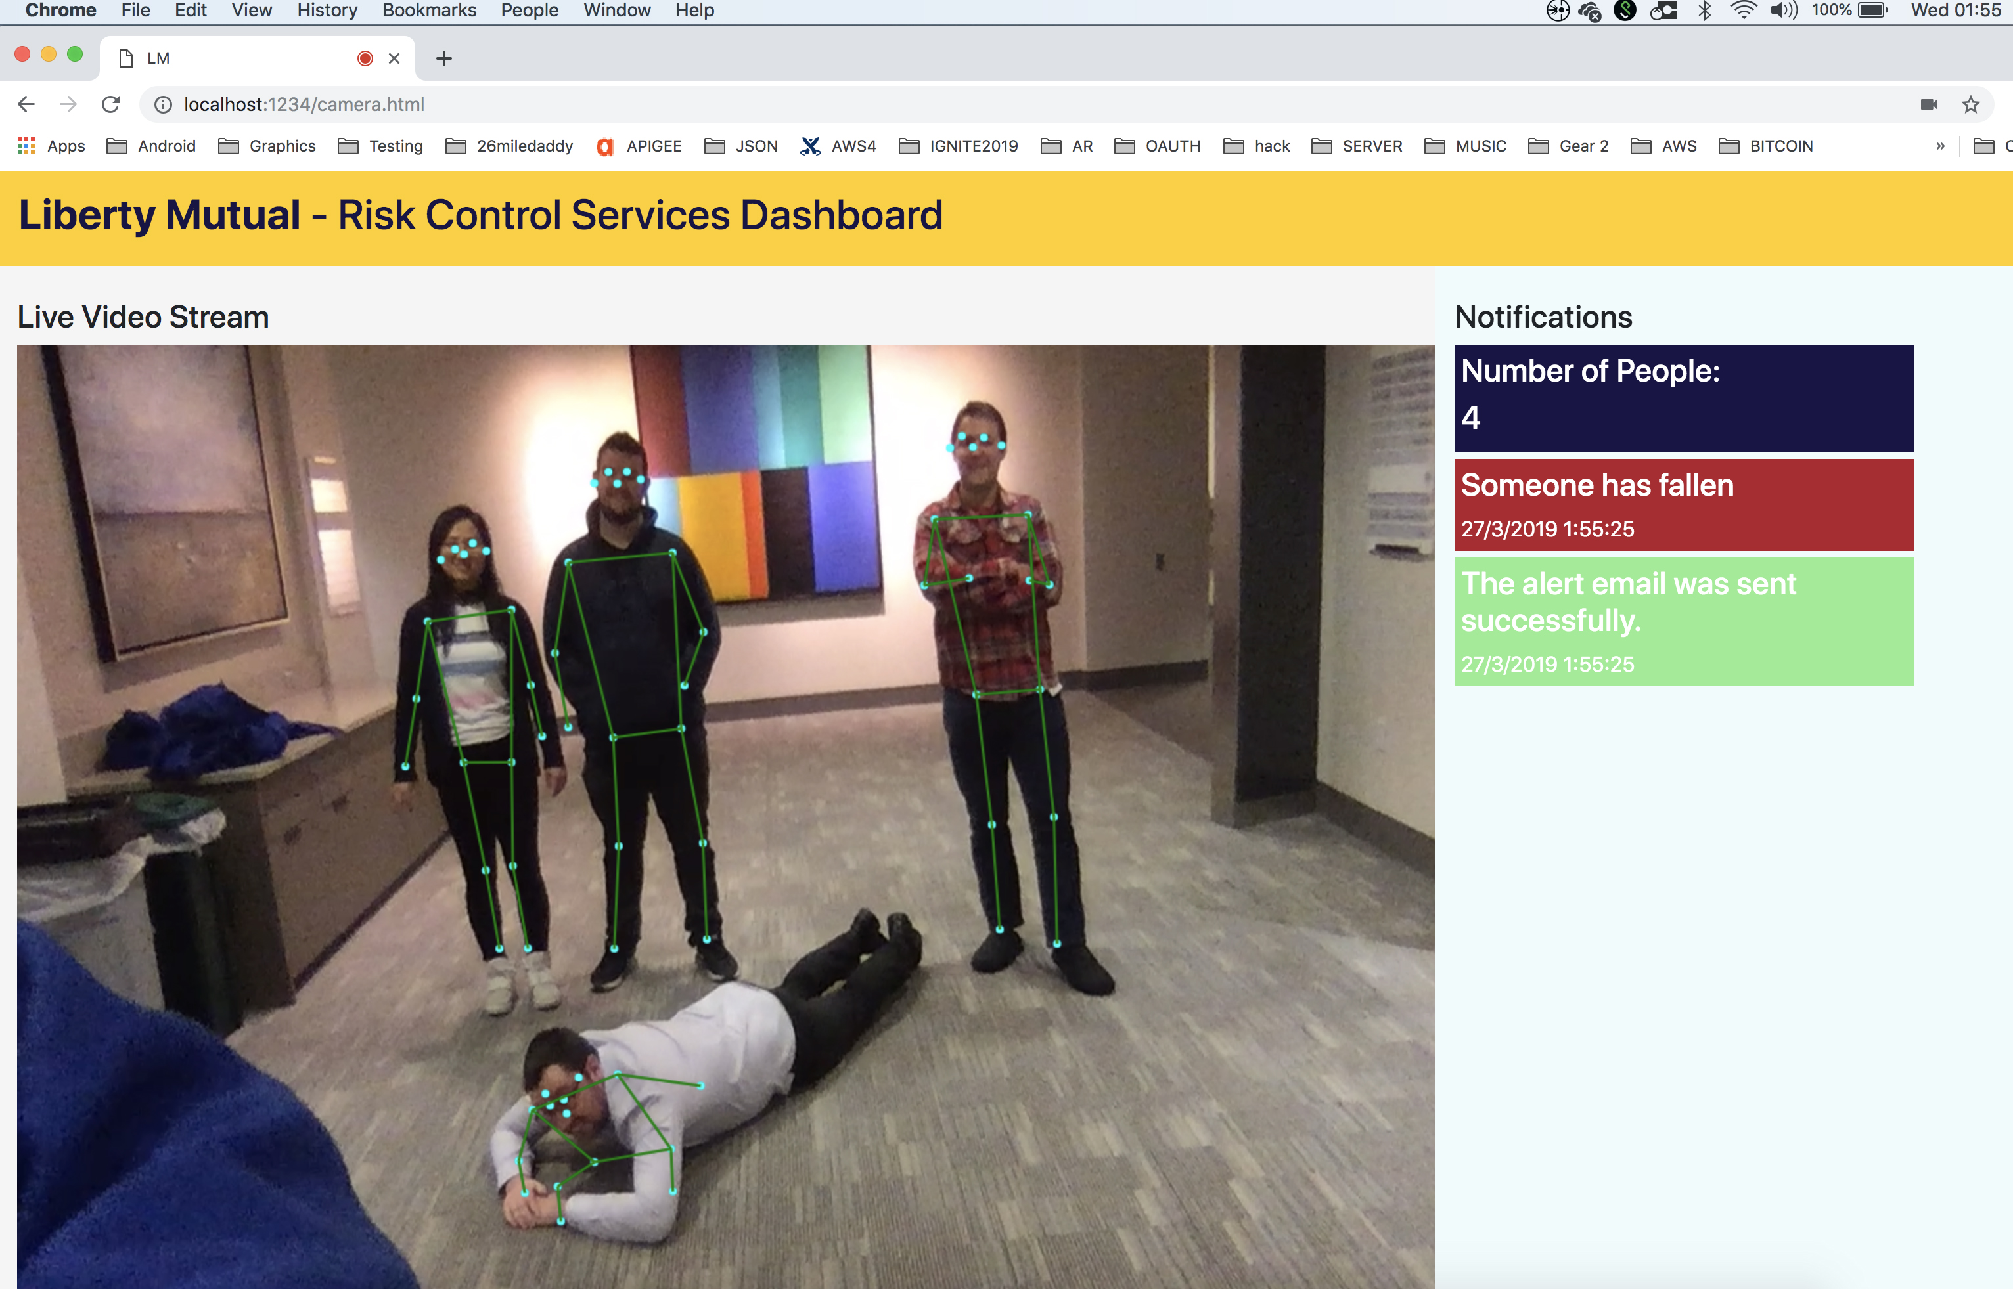
Fall
Detection
and
Alerting
(at
01:55 am)

Slide 12
LIVE DEMO!

Slide 13
Reduce Risk, Reduce Claims, Generate Revenue
Machine Learning to solve an enduring problem
Customer interest and existing need
Business interest and input

Slide 14
Next Steps
Further exploration of business case with RCS
Further exploration of customer requirements
Explore more platforms – 360˚ Cameras, Remote Control Cars, Dashcams, Drones
Explore more Machine Learning models and algorithms
Explore more alerting methods

